Slide 1


BANGALORE TECHNOLOGICAL INSTITUTE Department of Computer Science & Engineering
INTERNSHIP PRESENTATION
Varcons Technologies Pvt Ltd
Full Stack Development using MERN STACK
Under the Guidance of
Mr.
(Assistant Prof.)
Prepared By
Prem Kumar Ghising
1BH20CS024

Slide 2
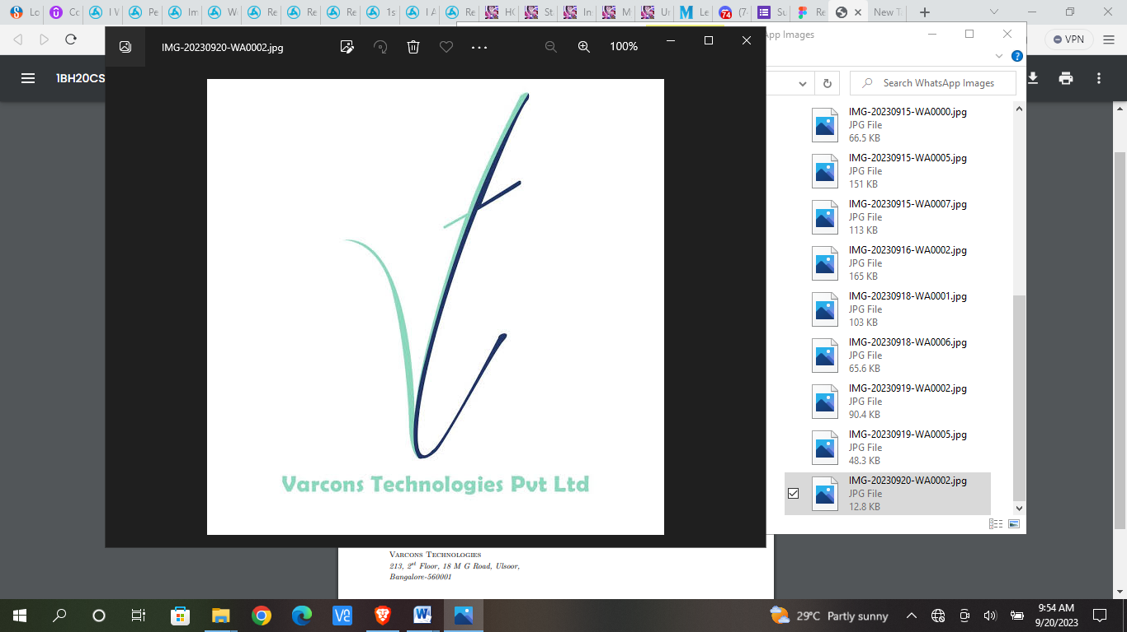
ABOUT THE COMPANY
VARCONS TECHNOLOGIES, was incorporated with a goal ”To provide high quality and optimal Technological Solutions to business requirements of our clients”.
VARCONS TECHNOLOGIES is a Technology Organization providing solutions for all web design and development, MYSQL, PYTHON Programming, HTML, CSS, ASP.NET and LINQ.
VARCONS TECHNOLOGIES delivers high-quality solutions to clients in various sectors whether it is a business enterprise looking for a reliable enterprise resource planning (ERP) system, an entrepreneur looking for a mobile application to grow their business, or an educational institution looking for a robust learning management system (LMS).
The company works closely with its clients to define their exact solution requirements, and provides IT solutions consulting services with high-caliber consultants.

Slide 3
Service Offered By Company
Website as Software
Branding and Design
Search Engine Optimization
Analytics and Research
Comprehensive Customer Support
Embedded Systems and IOT
Product Of Company
Android APP
Web Application
Web Design

Slide 4
INTERNSHIP OBJECTIVES
Providing hands-on experience in full stack Web development, including design, coding, and testing.
Exposing interns to various tools and technologies used in full stack web development.
Encouraging creativity and innovation in problem-solving and design.
Developing communication and collaboration skills through team projects and mentorship.

Slide 5
INTERNSHIP DETAILS
Start Date : 11th August 2023
End Date: 10th September 2023
Total Duration: 1 month
Guide : Spoorthi C
Office Hours: 10:00 AM to 3 PM
Office Days: Monday to Saturday

Slide 6
PROJECT INTRODUCTION
Project aims to revolutionize the existing landing page for our tech startup.
A landing page serves several important purposes for individuals, businesses, and organizations
The dashboard is built using React.js, a popular JavaScript library for building user interfaces, and it leverages various libraries and tools from the React ecosystem to create a responsive and customizable dashboard.
Services can vary greatly depending on the industry, niche, and specific goals of the entity.

Slide 7
Services
Here are some types of services provided by our project
Consulting Services:
Business Consulting
Management Consulting
Financial Consulting
IT Consulting
Marketing Consulting
Professional Services:
Legal Services
Accounting and Tax Services
Human Resources (HR) Services
Architecture and Engineering Services

Slide 8
RESEARCH PROBLEM
User experience (UX) design: This could include conducting user research and testing to determine the most intuitive and efficient layout, navigation, and features for the dashboard.
Performance optimization: This could include analyzing and improving the loading speed, responsiveness, and overall performance of the dashboard.
Data visualization: This could involve researching the best data visualization techniques, such as charts, graphs, and tables, and testing them with users to determine which ones are most effective.
Integration with external systems: This could include researching and testing different integration tools and techniques, as well as evaluating the security and reliability of the integration.
Accessibility: This could include researching and implementing accessibility features, such as keyboard navigation, screen reader support, and color contrast adjustments.

Slide 9
INTERNSHIP CURRICULUM
HTML : HTML is the foundation of web development and is essential for creating static web pages and dynamic web applications. It uses a set of predefined tags to structure and format the content of a web page, such as headings, paragraphs, lists, links, and images.
CSS : CSS is an essential part of web development and is used to create visually appealing and user-friendly websites and web applications. CSS is used to control the layout, formatting, and appearance of a web page, such as the color, font, size, and position of text and images.
JavaScript: JavaScript is a high-level programming language used to create interactive and dynamic web pages and web applications. It is a client-side scripting language, which means it runs on the user's browser and can manipulate the HTML and CSS on the fly, without requiring a server-side request. It is widely used in web development to create interactive forms, menus, animations, and other dynamic features.

Slide 10
Frontend frameworks : These frameworks provide a set of tools, components, and design patterns to streamline and accelerate the development process, making it easier to create responsive, interactive, and visually appealing web applications. Front-end frameworks such as React, Angular, Vue.js, and Bootstrap are widely used in modern web development and help developers create complex UI components and manage application state more efficiently.
Version control and collaboration: Version control is a system that allows developers to manage changes made to code over time. Git is a popular distributed version control system that allows developers to track changes made to their code, collaborate with others, and revert to previous versions if necessary. GitHub is a web-based platform that provides hosting for Git repositories and adds additional features for collaboration, such as issue tracking, pull requests, and code review.

Slide 11
INTERNSHIP SCHEDULE
First Week
We also got to know the basics of web development and insights on HTML and advance HTML5, CSS and CSS Layouts.
Introduction to bootstrap and portfolio project
Second Week
Second week started with introduction of JavaScript, comparison, Boolean functions, arrays, loops
Basic concepts of OOPS DOM Constructor, Destructor, introduction to DOM selectors
Minor project discussion like calculator app

Slide 12
Third Week
In this week we apply all the learning and did some minor design projects using Javascript, HTML, CSS.
We revise all the concepts that we learned on previous week.
Fourth Week
We learned about basic concepts in ReactJS such as JSX, components, state, and props and Styling in ReactJS and React Router for Routing.
Introduction to Redux and Building the user interface of the admin dashboard and implementing charts and graphs using libraries such as Chart.js or D3.js
Best practices for optimizing ReactJS applications such as code splitting, lazy loading, and performance testing and Continuous integration and deployment and GitHub Actions.

Slide 13
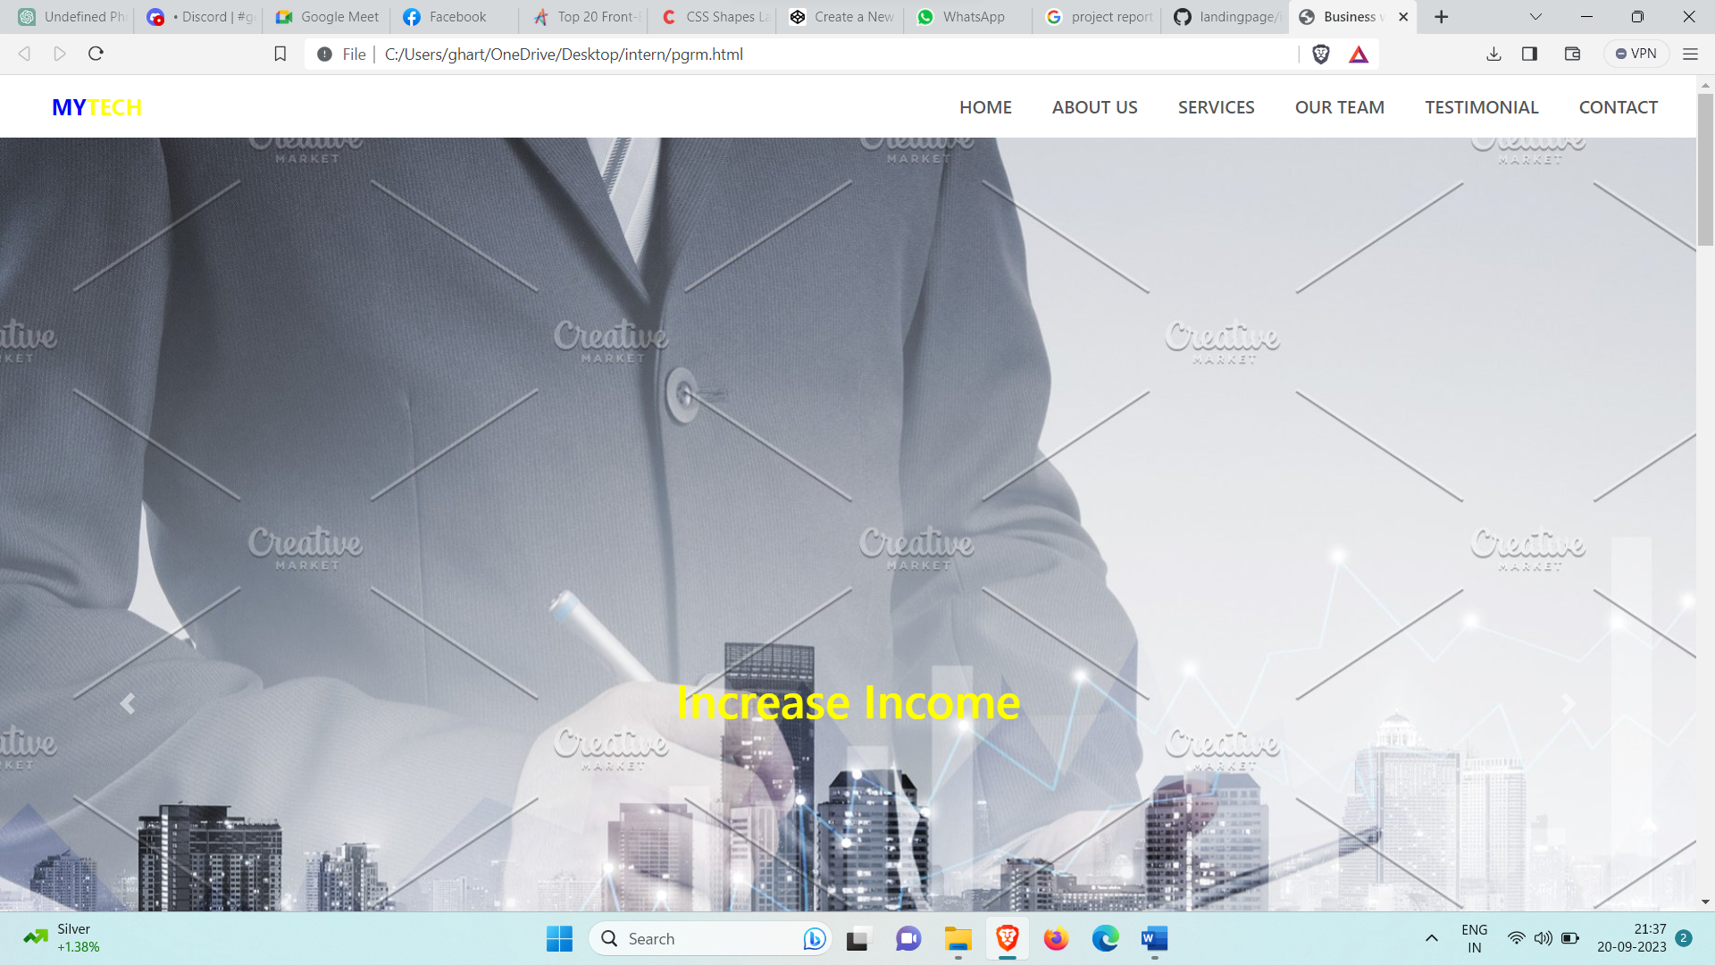
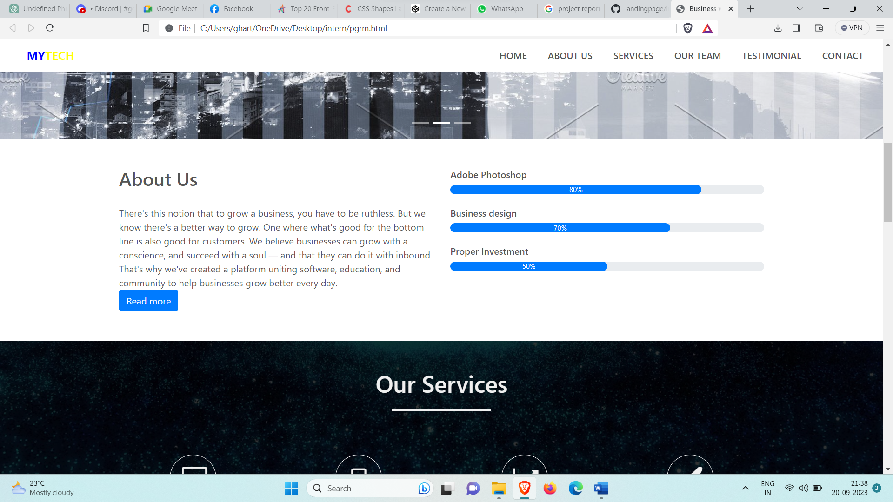
Project Snapshots

Slide 14
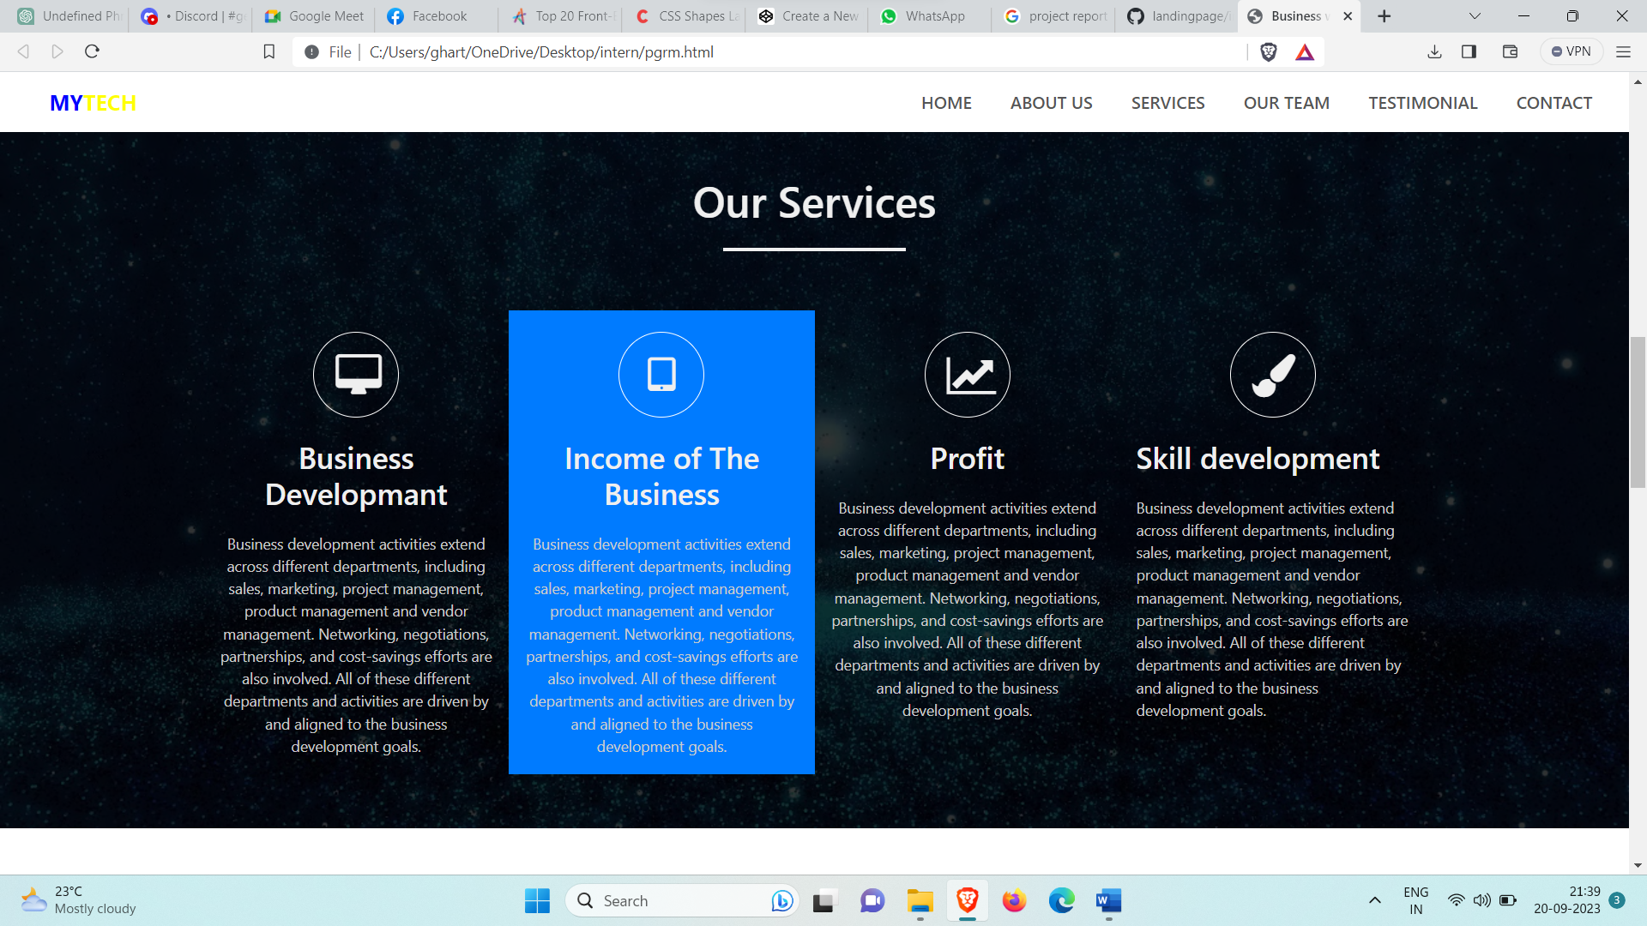
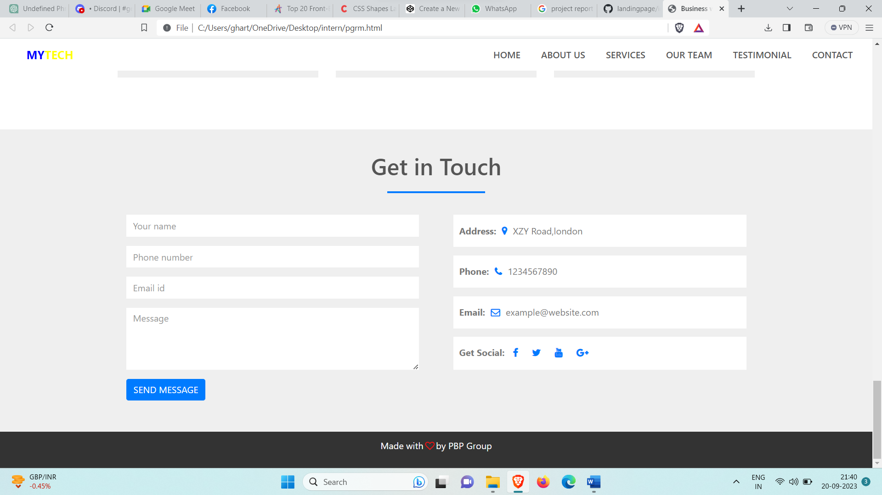

Slide 15
CONCLUSION
In conclusion, the internship has provided a valuable opportunity to learn and develop skills in building modern web applications using React.js, one of the most popular front-end frameworks in the industry. Through this internship, I have gained practical experience in developing a fully functional dashboard application that provides insights and analysis of data, manages data, and allows for customization and collaboration. I have also learned about important concepts such as data visualization, user interface design, state management, and integration with other systems and tools. This internship has equipped me with the necessary skills and knowledge to pursue a career in web development and to contribute to the development of innovative and impactful web applications.

